Slide 1
CS 4530 & CS 5500
Software Engineering
Lesson 12.3: Strategies for successful software teams
Jonathan Bell, John Boyland, Mitch Wand
Khoury College of Computer Sciences © 2021, released under CC BY-SA

Slide 2
Learning Objectives for this Lesson
By the end of this lesson, you should be able to…
Explain key advantages of working in a team and sharing information with your team
Apply root-cause analysis to construct a blameless post-mortem of a team project

Slide 3
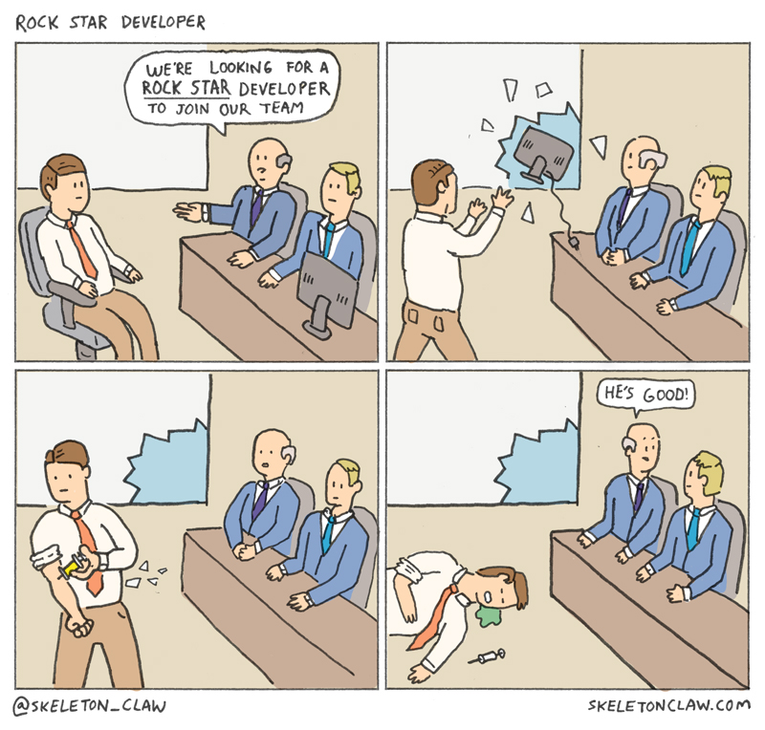
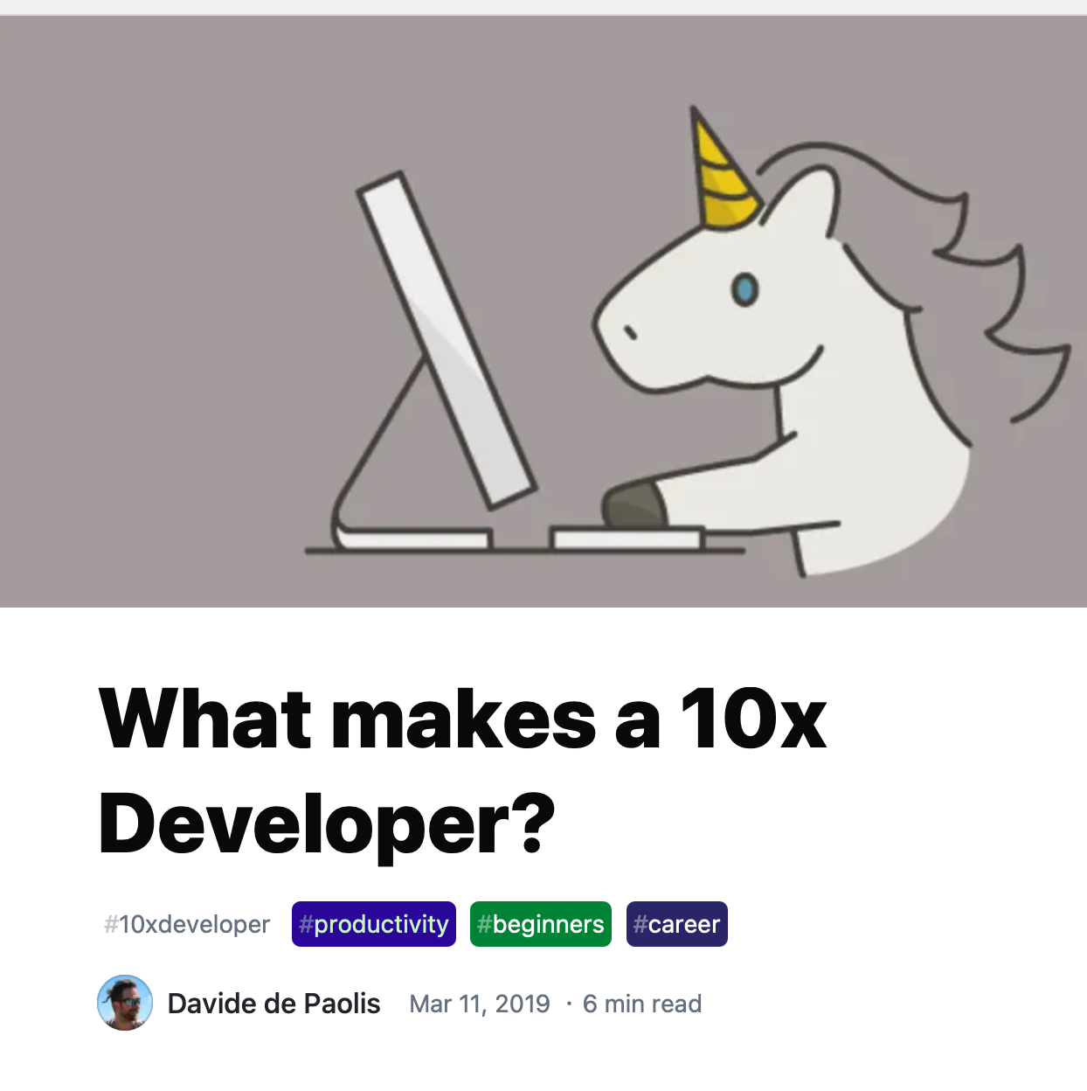
“The 10x Engineer”
AKA “The Rock-Star Engineer,” “The Ninja Developer”
Notes:
Creating any non-trivial project requires a strong team. This might seem counter-intuitive to some, perhaps given an instinct to find and worship idols. Who are our SE idols? Linus Torvalds, Guido Van Rossum, Bill Gates? Weren’t each of these individuals responsible for building something big?
Linus didn’t write linux alone: wrote beginnings of PoC Unix-like kernel, show to mailing list, form community, lead people and coordinate work. Not result of his PoC Unix-like kernel, but result of community. Also: what about Unix? Not just Ken Thompson + Dennis Ritchie, but big group at Bell Labs,
Guido Van Rossum dien’t personally create Python: he wrote first version sure (in 1991!), but hundreds of others contributed to later versions, made it what it is now (not to mention package eco-system… num-py!!)
Steve Jobs led a team that built the Mac. Bill Gates might have written a BASIC interpreter, but is probably better known for building an enormous company around MS-DOS
Genius Myth is our tendency to ascribe success of a team to a single person or its leader. Key is that we are able to form a team and collaborate, sharing knowledge

Slide 4
Playing Nicely with Others
HRT: Three Pillars of Social Skills
Pillar 1: Humility: You are not the center of the universe (nor is your code!). You’re neither omniscient nor infallible. You’re open to self-improvement.
Pillar 2: Respect: You genuinely care about others you work with. You treat them kindly and appreciate their abilities and accomplishments.
Pillar 3: Trust: You believe others are competent and will do the right thing, and you’re OK with letting them drive when appropriate.
From “Debugging Teams” by Ben Collins-Sussman and Brian Fitzpatrick
Notes:
If we agree that there are no 10x engineers, and that we need to form effective teams in order to scale up our software engineering processes, then perhaps we can agree on some ground-rules for working productively with our team mates. These three pillars are taken from the book “Debugging Teams” - the authors of this book are long-time software team leads at Google. Both trace almost every social conflict that they have witnessed in their orgs back to a lack of one of these three traits. This lens (HRT, pronounced “heart”) is useful for evaluating all kinds of personal conflicts. We work with others, and will be most effective when we can create long-lasting relationships with our colleagues who will be able to help us out later when we need. For example: nobody wants to work with someone who consistently behaves like they are the smartest person in the room. Give and receive constructive criticism.

Slide 5
HRT Applied in Code Review
Consider the following code comment
This is personal
Is this really that black and white?
“Man, you totally got the control flow wrong on that method there. You should be using the standard foobar code pattern like everyone else”
Are we demanding a specific change?
Everyone else does it right,
therefore you are stupid
From “Debugging Teams” by Ben Collins-Sussman and Brian Fitzpatrick

Slide 6
HRT Applied in Code Review
Consider the following code comment
“Man, you totally got the control flow wrong on that method there. You should be using the standard foobar code pattern like everyone else”
“Hmm, I’m confused by the control flow in this section here. I wonder if the foobar code pattern might make this clearer and easier to maintain?
Humility! This is about me, not you
From “Debugging Teams” by Ben Collins-Sussman and Brian Fitzpatrick
Notes:
Don’t outright say they are wrong: you are just having trouble understanding it. Could be your fault or theirs. Not demanding any specific change, but suggest something that might help improve. No discussion of the author’s value or coding skills

Slide 7
The 10x Team, or the 1/10 Team?
Mythical Man-Month: “adding manpower to a late software project makes it later”
Knowledge sharing needs to scale linearly (or sub linearly) with org growth:
Mentorship
Q&A
Mailing lists
Tech talks
Documentation
For more on knowledge sharing in teams, see SE@Google Ch 3
Notes:
A strong and effective team relies on effective knowledge sharing. Recall Brooks’ law - adding more manpower to a late project makes it later - this was because for each team member that you added, that new team member would need to communicate and coordinate with multiple existing team members, hence reducing the productivity of the rest of your team. Instead, effective teams focus on the kind of knowledge sharing that grows linearly or even better, sub-linearly with the size of your team, like Q&A platforms (such as stack overflow), mailing lists, internal presentations, and documentation. By engaging our HRT pillars, we can create an environment that provides the psychological safety to our teammates that they will feel capable of asking for the kind of support that they need in order to be the most effective teammates that they can be.

Slide 8

Bus Factor & Importance of Knowledge Sharing
How many of your team members are irreplaceable?
Notes:
Speaking of metrics, in the context of teams and team performance, one important metric to consider is the bus factor: which is to say, how many members of your team are entirely irreplaceable, the sole holders of particular, specialized knowledge? If your team can only operate because of one developer who knows in detail how your system works (and this is not documented anywhere), if that developer “gets on a bus” (and doesn’t come back), can your team recover? Effective teams formalize this important knowledge, ensuring resiliency in the event that a team member leaves the group for a variety of reasons (be it to get a new job, or simply moving based on personal constraints)

Slide 9

Failures are inevitable
In software, humans, and processes
Notes:
It’s extremely likely that you will, if you have not yet, experienced a problem on your team. Perhaps you had a significant software failure (like a bug being released into production, or someone delaying the development process), a human failure (like interpersonal issues with a teammate) or a process failure (like a testing system that doesn’t actually test what you thought it would) …the most important thing is to learn from mistakes. How do you learn from mistakes? The process of reflecting on and learning from these mistakes can be formalized into a “post mortem” review

Slide 10
Post-Mortems
Google’s Example Case Study
Shakespeare search service down for 66 minutes during period of high interest in Shakespeare
Engineer quickly noticed the problem and eventually got a fix in
How does an organization learn from this?
What went well
What went wrong
Where we got lucky
How do we prevent it from happening again?
Notes:
We’ll look at an example of a post-mortem. This example is fictitious, but the outage described, reason for the outage, and the postmortem itself are representative of real failures and post-mortem inside of Google. The example is situated in Google’s Shakespeare search engine - and the scenario describes an outage that occurred due to a sudden spike in interest in the service, combined with a resource leak that hadn’t been noticed when the service wasn’t under high load. An on-call engineer was alerted, but the slow resolution still resulted in 66 minutes of downtime. Given a service that might aim for 99.99% availability, this 66 minutes exceeds your downtime budget for the entire year. So, this is actually a very bad thing. The idea behind the post-mortem process is to learn from this, so that 1: the same service won’t go down again this year, and 2: other services that experience similar issues will be able to avoid similar problems

Slide 11
Name, Blame and Shame
How not to respond to this failure
Some engineer contributes to failure or incident
Engineer is punished/shamed/blamed/retrained
Engineers as a whole become silent on details to management to avoid being scapegoated
Management becomes less informed about what actually is happening, do not actually find/fix root causes of incidents
Process repeats, amplifying every time
Notes:
It’s extremely important to consider *how* to conduct this post-mortem. In a naive approach (which we might call name, blame and shame), we might not be able to actually learn from this incident…

Slide 12
Blameless Post-Mortem
Why blameless?
What actions did you take at the time?
What effects did you observe at the time?
What were the expectations that you had?
What assumptions did you make?
What is your understanding of the timeline of events as they occurred?
Notes:
In order to figure out what went well, what didn’t, and where we were lucky, we need answers to all of these questions. How can we get true answers if there is fear of punishment or retribution? Engineer might misrepresent the actions that they took to make themselves look better, or play dumb about the effects that they saw

Slide 13
Blameless Post-Mortem
Google’s Example Case Study
Shakespeare Sonnet++ Postmortem (incident #465)
Date: 2015-10-21
Authors: jennifer, martym, agoogler
Status: Complete, action items in progress
Summary: Shakespeare Search down for 66 minutes during period of very high interest in Shakespeare due to discovery of a new sonnet.
Impact: Estimated 1.21B queries lost, no revenue impact.
Root Causes: Cascading failure due to combination of exceptionally high load and a resource leak when searches failed due to terms not being in the Shakespeare corpus. The newly discovered sonnet used a word that had never before appeared in one of Shakespeare’s works, which happened to be the term users searched for. Under normal circumstances, the rate of task failures due to resource leaks is low enough to be unnoticed.
Trigger: Latent bug triggered by sudden increase in traffic.
Resolution: Directed traffic to sacrificial cluster and added 10x capacity to mitigate cascading failure. Updated index deployed, resolving interaction with latent bug. Maintaining extra capacity until surge in public interest in new sonnet passes. Resource leak identified and fix deployed.
Detection: Borgmon detected high level of HTTP 500s and paged on-call.
WHAT WENT WELL
Monitoring quickly alerted us to high rate (reaching ~100%) of HTTP 500s
Rapidly distributed updated Shakespeare corpus to all clusters
WHAT WENT WRONG
We’re out of practice in responding to cascading failure
We exceeded our availability error budget (by several orders of magnitude) due to the exceptional surge of traffic that essentially all resulted in failures
WHERE WE GOT LUCKY
Mailing list of Shakespeare aficionados had a copy of new sonnet available
Server logs had stack traces pointing to file descriptor exhaustion as cause for crash
Query-of-death was resolved by pushing new index containing popular search term
Copyright © 2017 Google, Inc. Published by O'Reilly Media, Inc. Licensed under CC BY-NC-ND 4.0
Notes:
Note detailed root cause: high load AND resource leak, AND note that failure response was not quite right. Action items include approaches to prevent similar failures in future (by making system more fault tolerant + scalable), in addition to fixing the underlying cause of the resource leak, AND updating documentation to improve response times to cascading failures in future. No matter who introduced the resource leak, who set it up wrong, and whose fault in particular this was: most important is lessons learned

Slide 14
Conducting Postmortems
Reflecting on past team performance
Apply this technique after any event you would like to avoid in the future
Apply this to technical and non-technical events
Focus on improvement, resilience, and collaboration: what could any of the actors have done better?
Google’s generic postmortem template
Notes:
You can and should use this approach to reflect on any event that you would like to avoid in the future. Remember the pillars of HRT, and conduct a blameless post-mortem to learn from what happened, acknowledge what went wrong, but avoid pinning any particular blame to an individual. In fact, you might find that it’s useful to visibly reward people for doing the right thing, to encourage participation in this process and allow your entire organization to improve from that failure. For example, even if you were the one who took down Amazon’s S3 service for the entire east coast of the US for a few hours, maybe there was still something to learn - in Amazon’s postmortem of that incident, they describe the process changes that were made to prevent similar outages from happening in the future. It’s hard to change the past, but, we can always seek to improve. In the following lesson, we’ll discuss measurement approaches to understand how changing our development processes can improve productivity.

Slide 15
This work is licensed under a Creative Commons Attribution-ShareAlike license
This work is licensed under the Creative Commons Attribution-ShareAlike 4.0 International License. To view a copy of this license, visit http://creativecommons.org/licenses/by-sa/4.0/
You are free to:
Share — copy and redistribute the material in any medium or format
Adapt — remix, transform, and build upon the material
for any purpose, even commercially.
Under the following terms:
Attribution — You must give appropriate credit, provide a link to the license, and indicate if changes were made. You may do so in any reasonable manner, but not in any way that suggests the licensor endorses you or your use.
ShareAlike — If you remix, transform, or build upon the material, you must distribute your contributions under the same license as the original.
No additional restrictions — You may not apply legal terms or technological measures that legally restrict others from doing anything the license permits.

